Slide 1
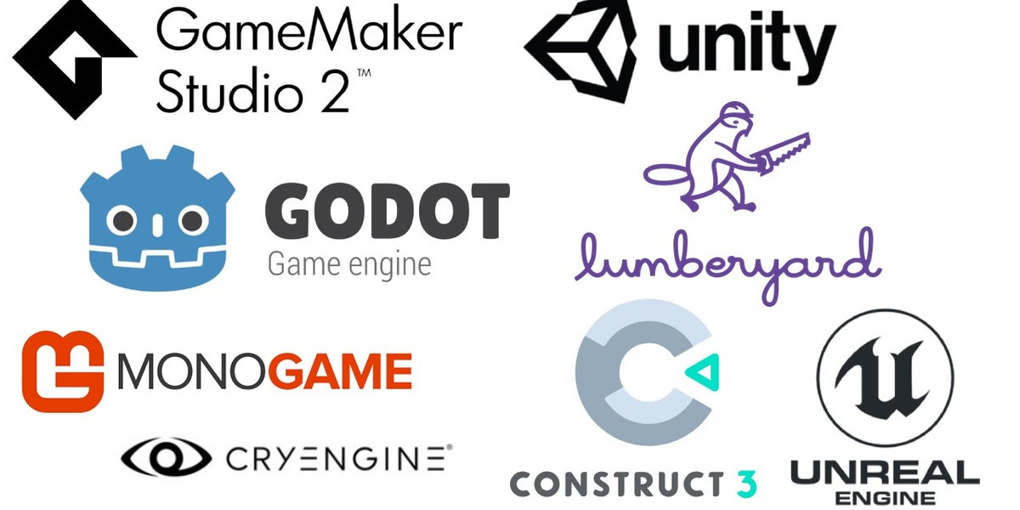
What is a Game Engine?
Game Engines are Software frameworks that are primarily designed for development of games
Makes game development process easier

Slide 2
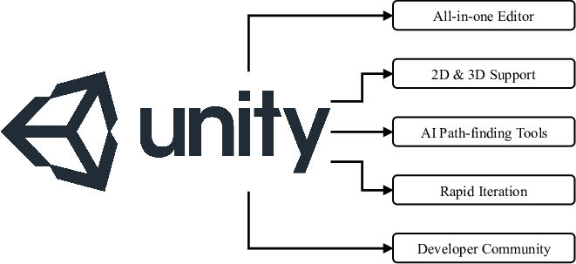

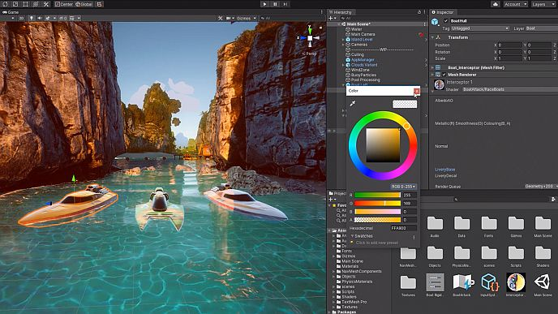
What is Unity?
Unity is one of the most popular and enterprise-friendly cross-platform game engine.
The scripting language of the Unity is C#

Slide 3
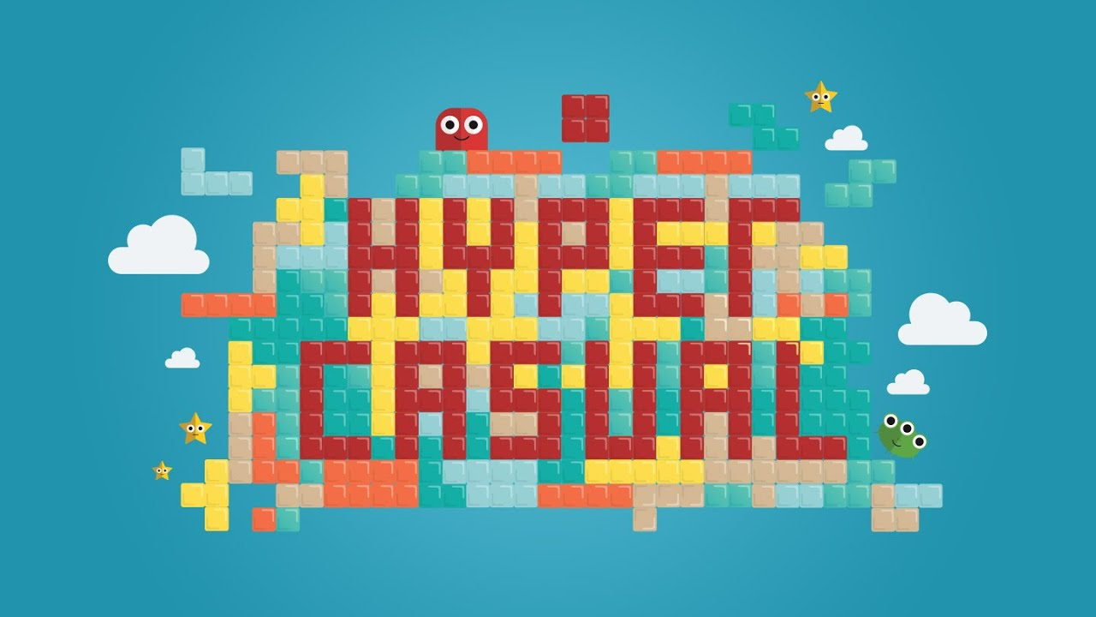
What is a Hyper Casual Game?
Hyper-Casual games have a short session length and enjoyable game mechanics, instantly playable games that players revisit frequently.
The mechanics, design, and concept of hyper casual games are all very simple.

Slide 4
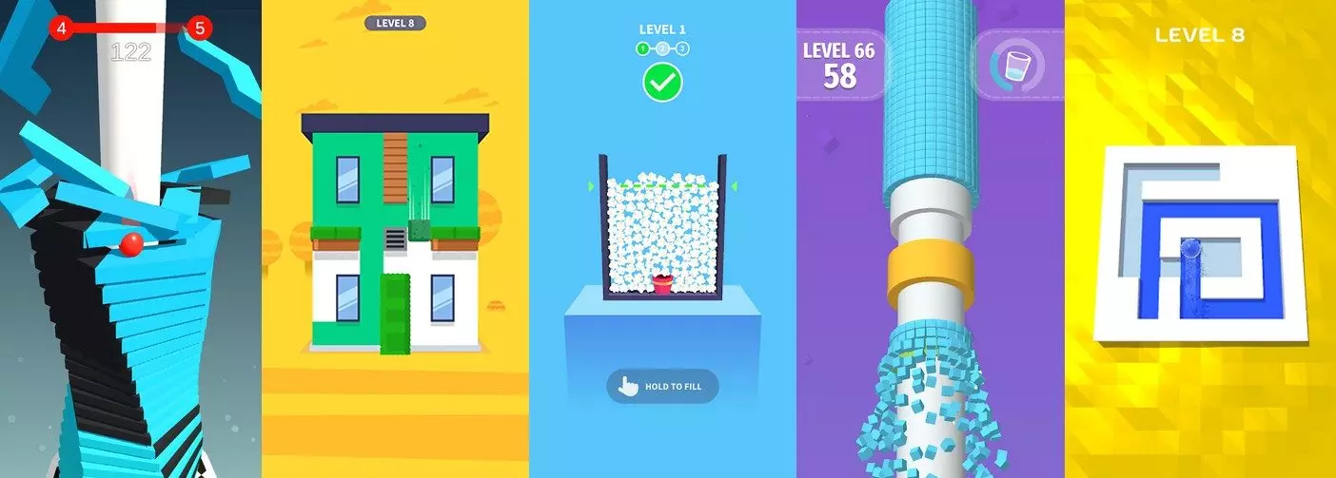
What is a Hyper Casual Game?
Some Example of Hyper-Casual Games
The mechanics, design, and concept of hyper casual games are all very simple.

Slide 5

What is a Hyper Casual Game?
Flappy Bird was the first hyper-casual game to reach widespread popularity, with over 50 million downloads and a daily revenue of roughly $50,000 during its peak.

Slide 6
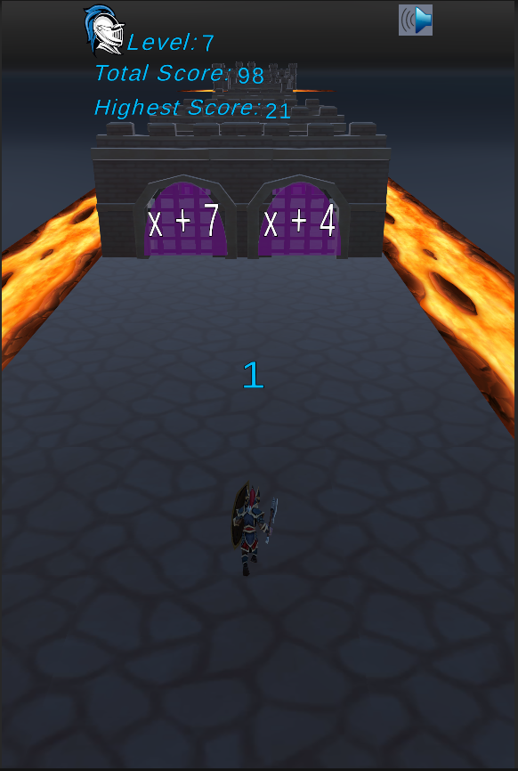
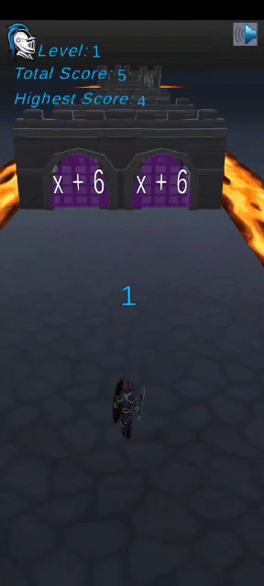
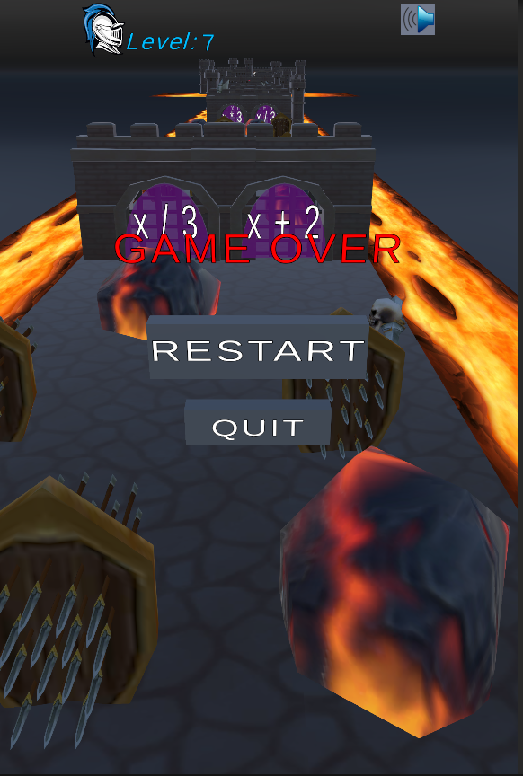
Definition of Project
Developing a qualified hyper casual game that contains all of the necessary features. Name of the game is “Medieval Souls”
Goal of the game is achieving the castle and defeating the skeleton army.
Notes:
Thank you for your presentation ağa, Hello I am Arda, now I will talk about our game Project more deeply. It is a hypercasual game and it is called Medieval Souls. The aim of the game is achieveing the castle at the end of the road and defeating the enemy.

Slide 7
Implementation of Game
Developed a class hierarchy that obeys game design principles
A flowchart has been designed to show game cycle.
Medieval Souls Game mechanics has been developed
Notes:
Let’s see implementation of game, we have developed a class hierarchy to create a more tidied structure and designed a flowchart to Show the cycle of game.

Slide 8
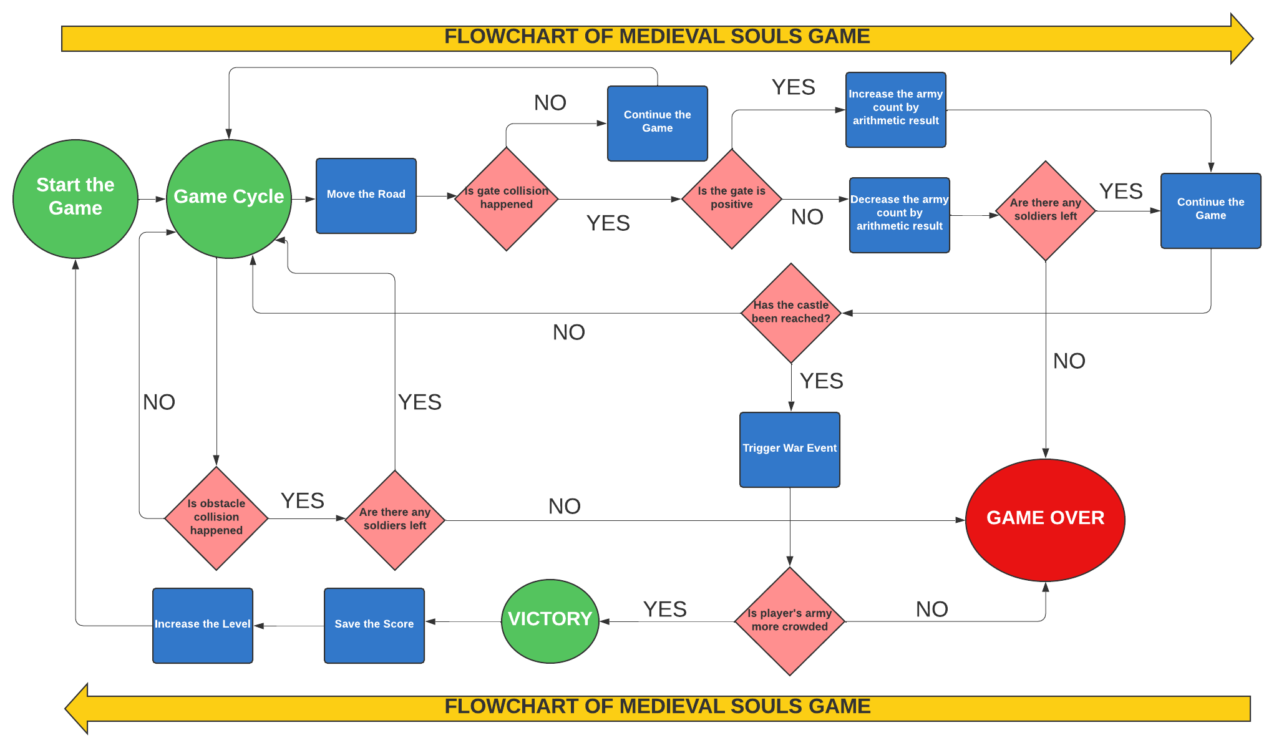

Slide 9
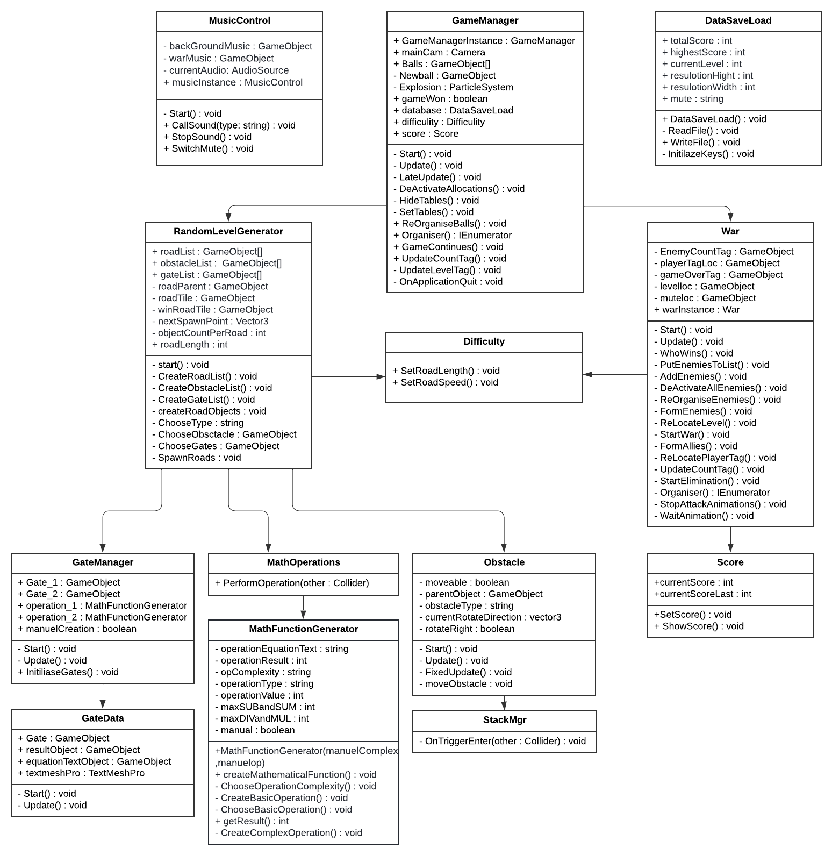
UML Class Diagram

Slide 10

Mechanics of the Game
Game fulfilled all of the tasks in the rubric successfully.
All of the features in the game except 3D models has been developed from the scratch by our team

Slide 11
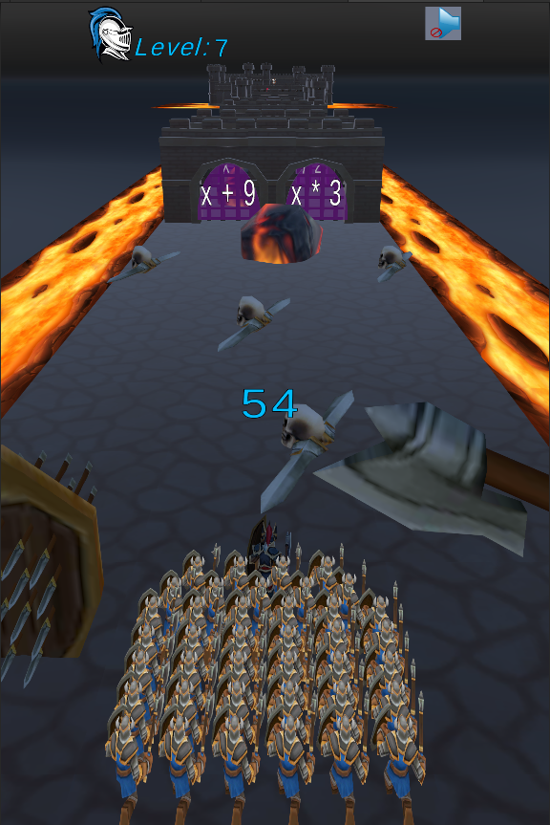
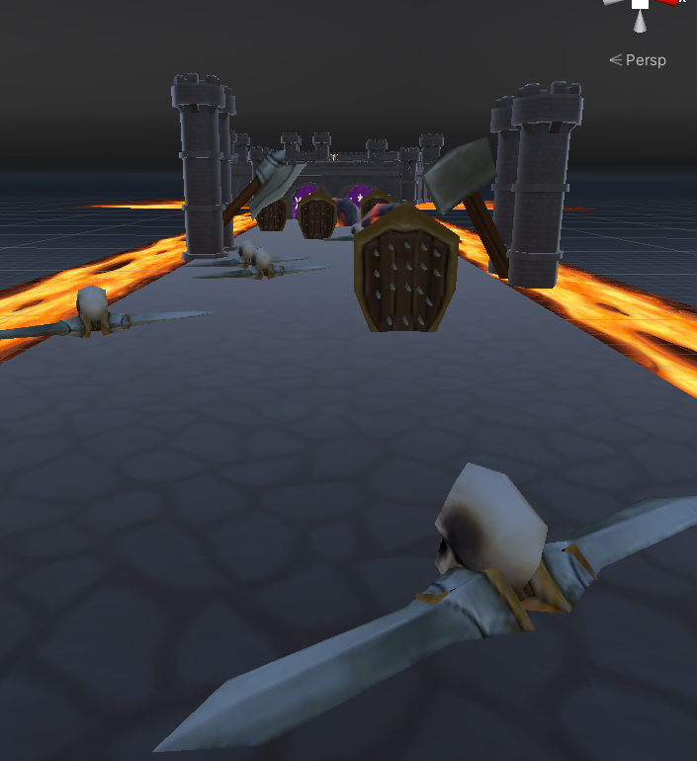
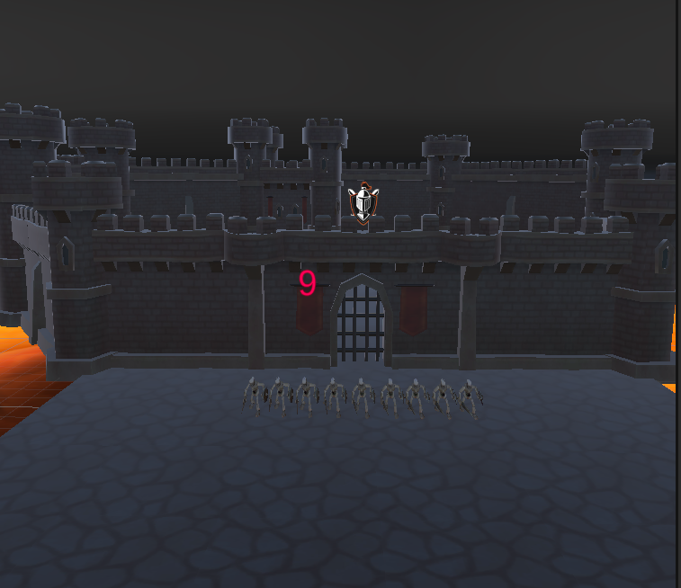
Mechanics of the Game
3D Graphics

Slide 12
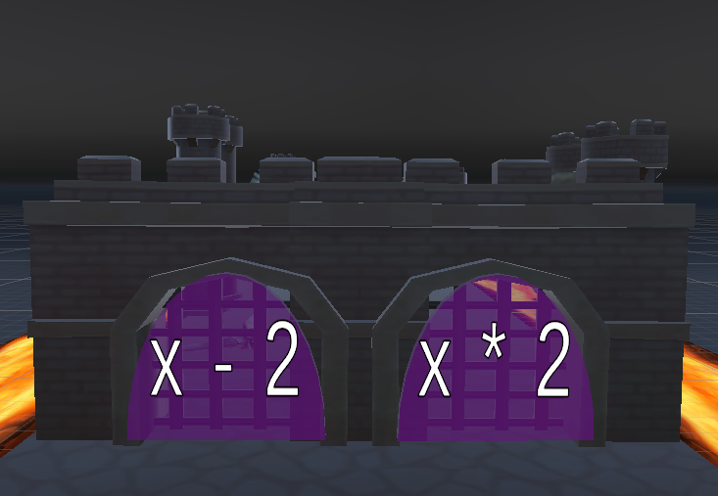
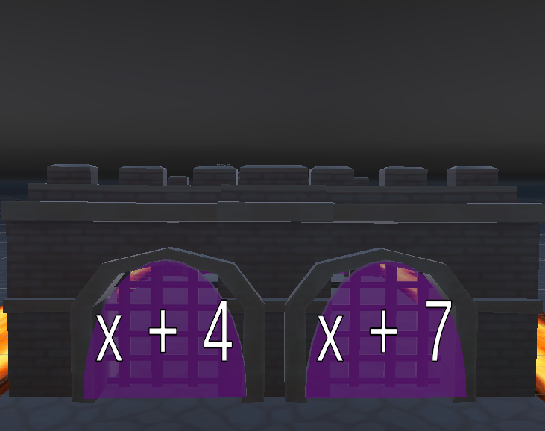
Mechanics of the Game
Gates

Slide 13
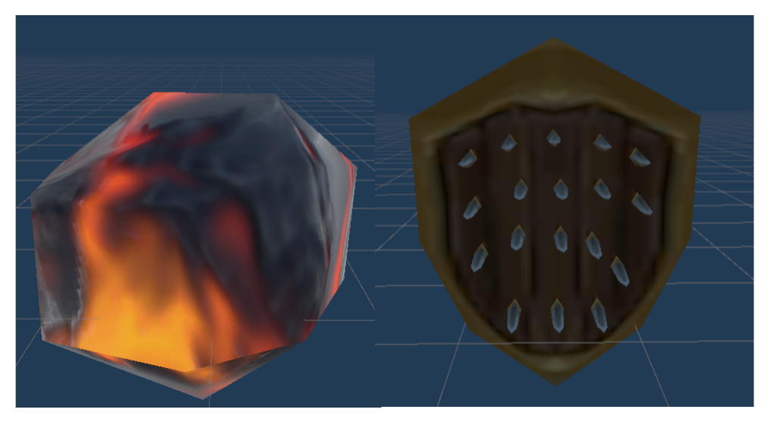
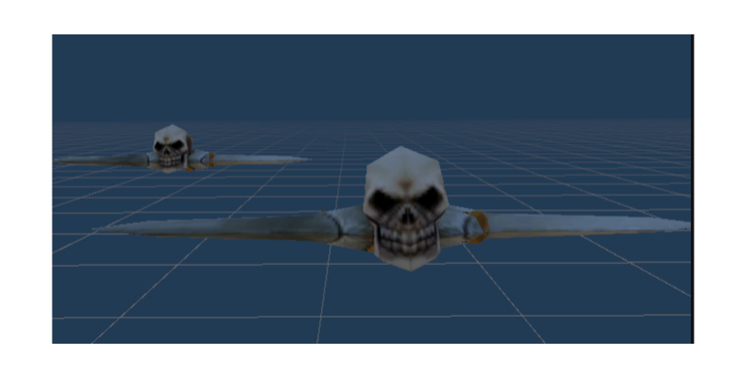
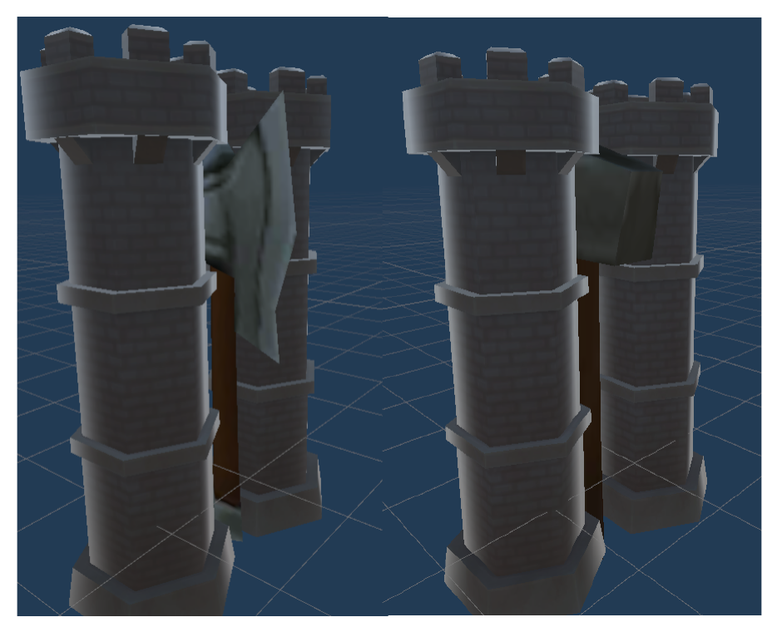
Mechanics of the Game
Obstacles

Slide 14
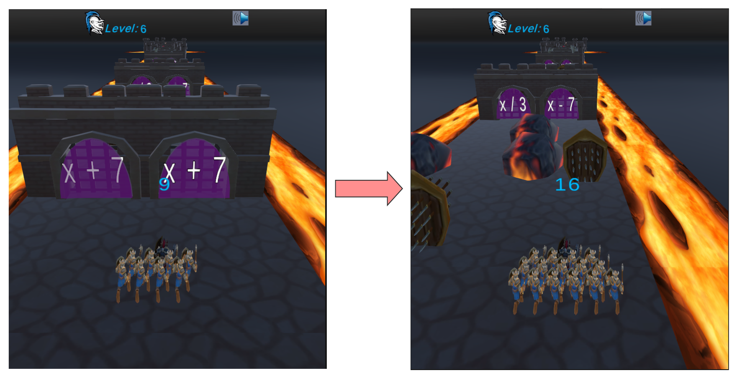
Mechanics of the Game
Army Growing Mechanics

Slide 15
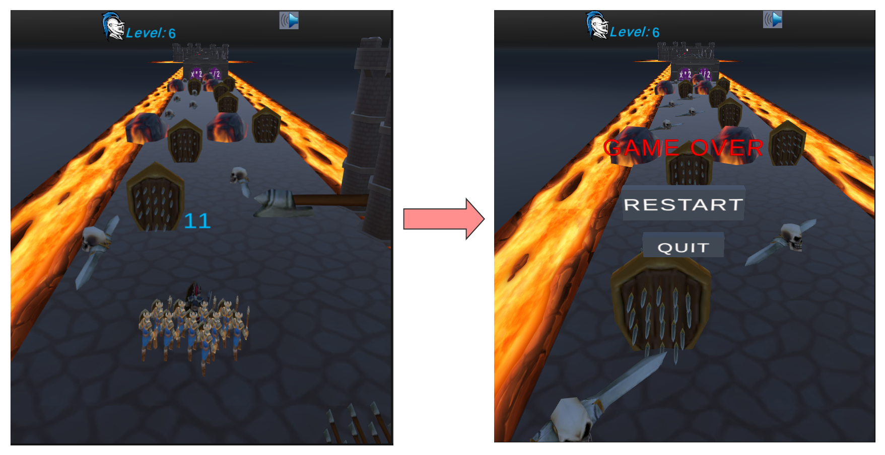
Mechanics of the Game
Army Loss Mechanics

Slide 16
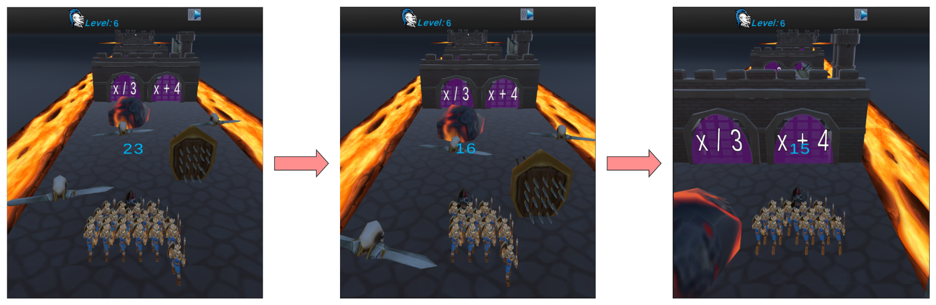
Mechanics of the Game
Army Formation Controller

Slide 17
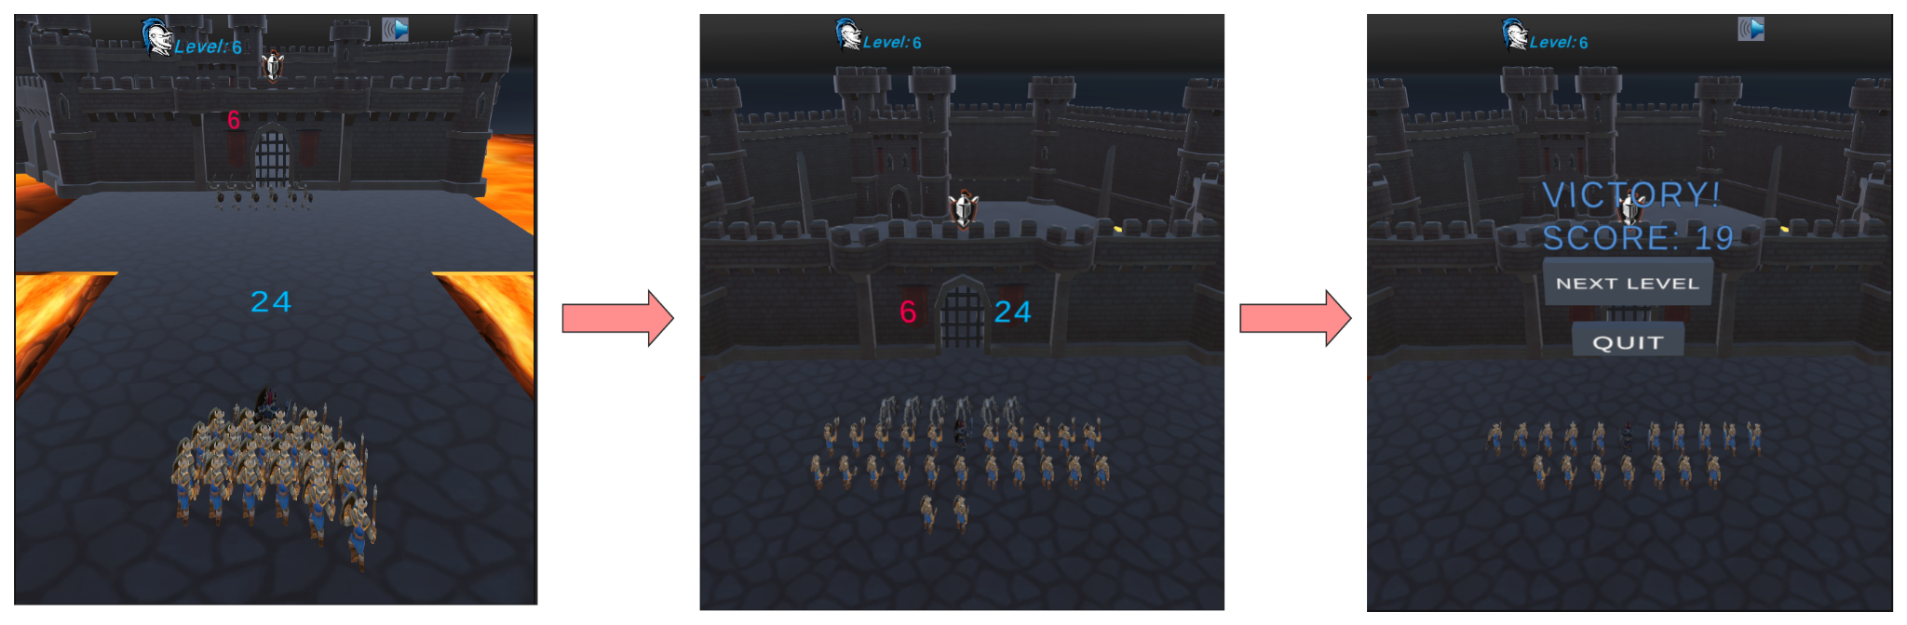
Mechanics of the Game
War Mechanics

Slide 18
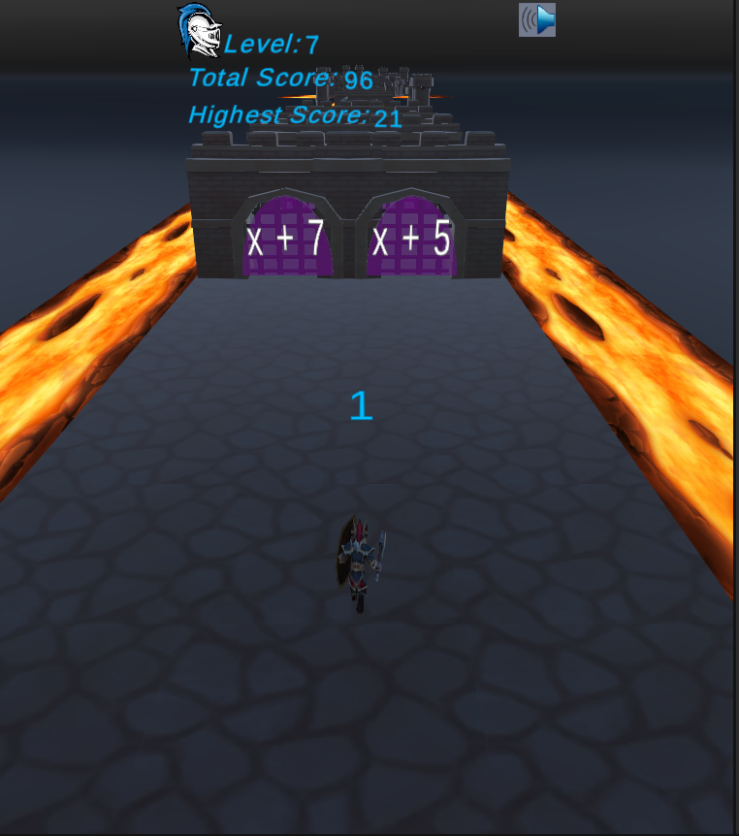

Mechanics of the Game
Score
Musics and Sounds

Slide 19


COMPATIBILITY

Slide 20
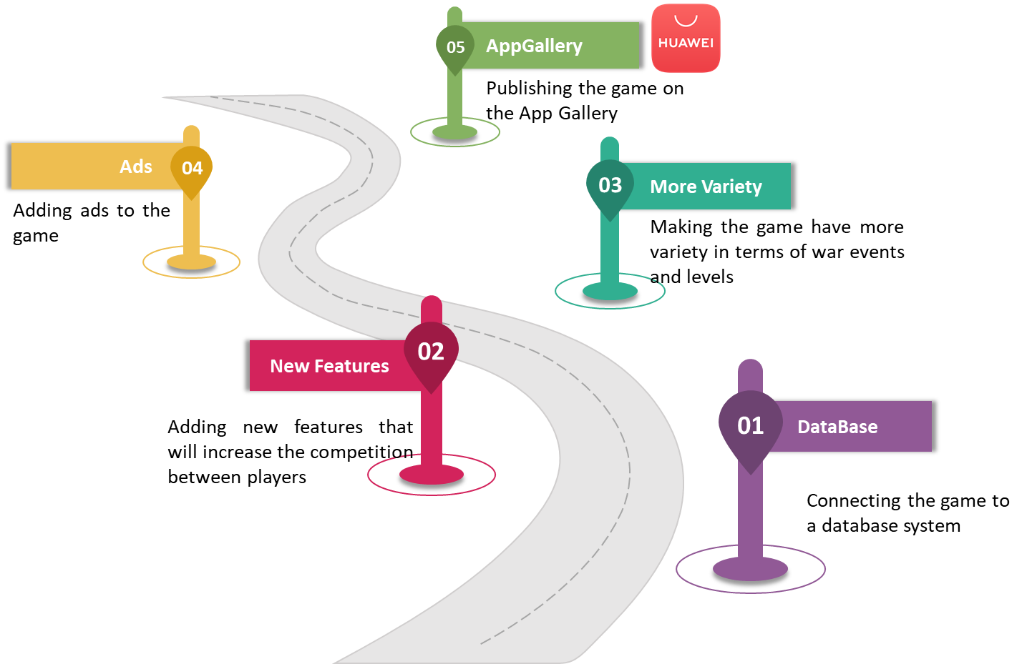
ROADMAP

Slide 21
Conclusion
All of the tasks in the rubric has been completed successfully
A qualified hyper casual game has been developed

Slide 22
Recommended Sources for Unity
Github Link of This Project :
https://github.com/Arda-Gokalp-Batmaz-AGB/Medieval-Souls-Game
https://unity.com/
https://unity.com/download
https://assetstore.unity.com/top-assets/top-free
https://www.youtube.com/watch?v=KTwUA2e2-o0&list=PLFFievnkbFiOEe-TBzI1QTm8gPHgsNeWw
https://www.youtube.com/watch?v=Bpj_AhxoVc8&list=PLgOEwFbvGm5pBCyEVYBYb-BXIy26KIOxT
https://www.youtube.com/watch?v=TcranVQUQ5U&list=PLgOEwFbvGm5o8hayFB6skAfa8Z-mw4dPV

Slide 23
References
[1]
“What’s the impact of COVID-19 on hyper casual games? | Game Industry News,” Game Industry News, 2020. https://mobidictum.biz/impact-of-
covid-19-on-hyper-casual-games/ (accessed May 16, 2022).
[2]
“Hyper-Casual Games,” AppLovin, Jan. 30, 2021. https://www.applovin.com/glossary/hyper-casual-games/ (accessed May 16, 2022).
[3]
AppsFlyer, “Hyper casual games: How lightweight apps became the heavyweights of mobile gaming,” AppsFlyer, Oct. 25, 2021. https://www.appsflyer.com/blog/mobile-marketing/hyper-casual-games/ (accessed May 16, 2022).

